Slide 1


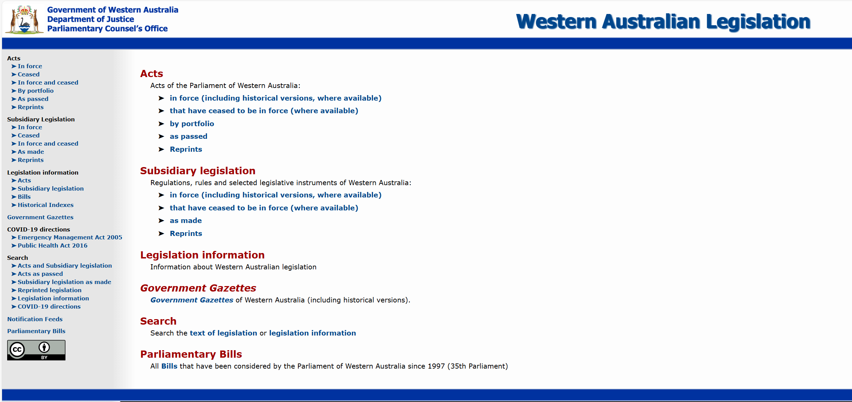
How to read legislation
A short guide to understanding Western Australian legislation

Slide 2
What this guide covers
Acts and Bills
Hierarchy of components in Acts
Building blocks of Acts
Key provisions
Acts that can affect meaning
Helpful things
How amending Bills work
Marked up principal Acts for amending Bills

Slide 3
Where to find WA legislation
Western Australian legislation website (WALW) www.legislation.wa.gov.au
  Acts
  Subsidiary legislation
  Government Gazettes
  Legislation information
Commonwealth legislation: Federal Register of Legislation

Slide 4
PCO’s objective: to draft good law
    To ensure that the law is necessary, clear, coherent, effective and accessible.

Slide 5
Acts and Bills
Act (statute): law passed by both Houses of WA Parliament and assented to by Governor
2 kinds of WA Acts:
  Principal: contains substantive legal provisions
  Amending: repeals or amends Acts
Bill: proposed Act introduced into WA Parliament and subject to amendment in either House (with some limitations)

Slide 6

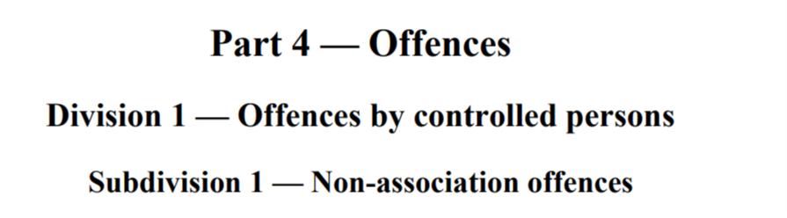
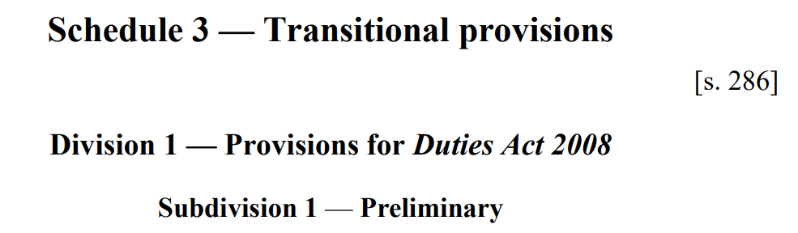
Hierarchy of components in Acts
Chapter (rare)
Part
Division
Subdivision
Schedule

Slide 7


Hierarchy of components in Acts
Act
Chapter
Part
Division
Subdivision
Schedule

Slide 8
Building blocks of Acts
Section (Act)/Clause (Bill)
Subsection (Act)/Subclause (Bill)
Definition
Paragraph
Subparagraph
Subsubparagraph (item)
Example/note

Slide 9
Building blocks of Acts
Example/note
Section
Subsection
Definition
Paragraph
Subparagraph

Slide 10
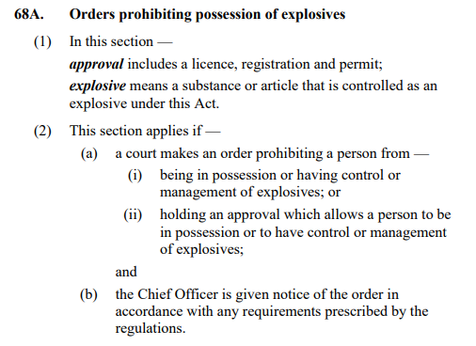
Section/clause
Clause/section heading
Subclause/subsection
Definition
Paragraph
Subparagraph

Slide 11
Key provisions
Long title
Short title
Commencement
Terms used (definitions)
Act binds Crown
Purpose/object

Slide 12
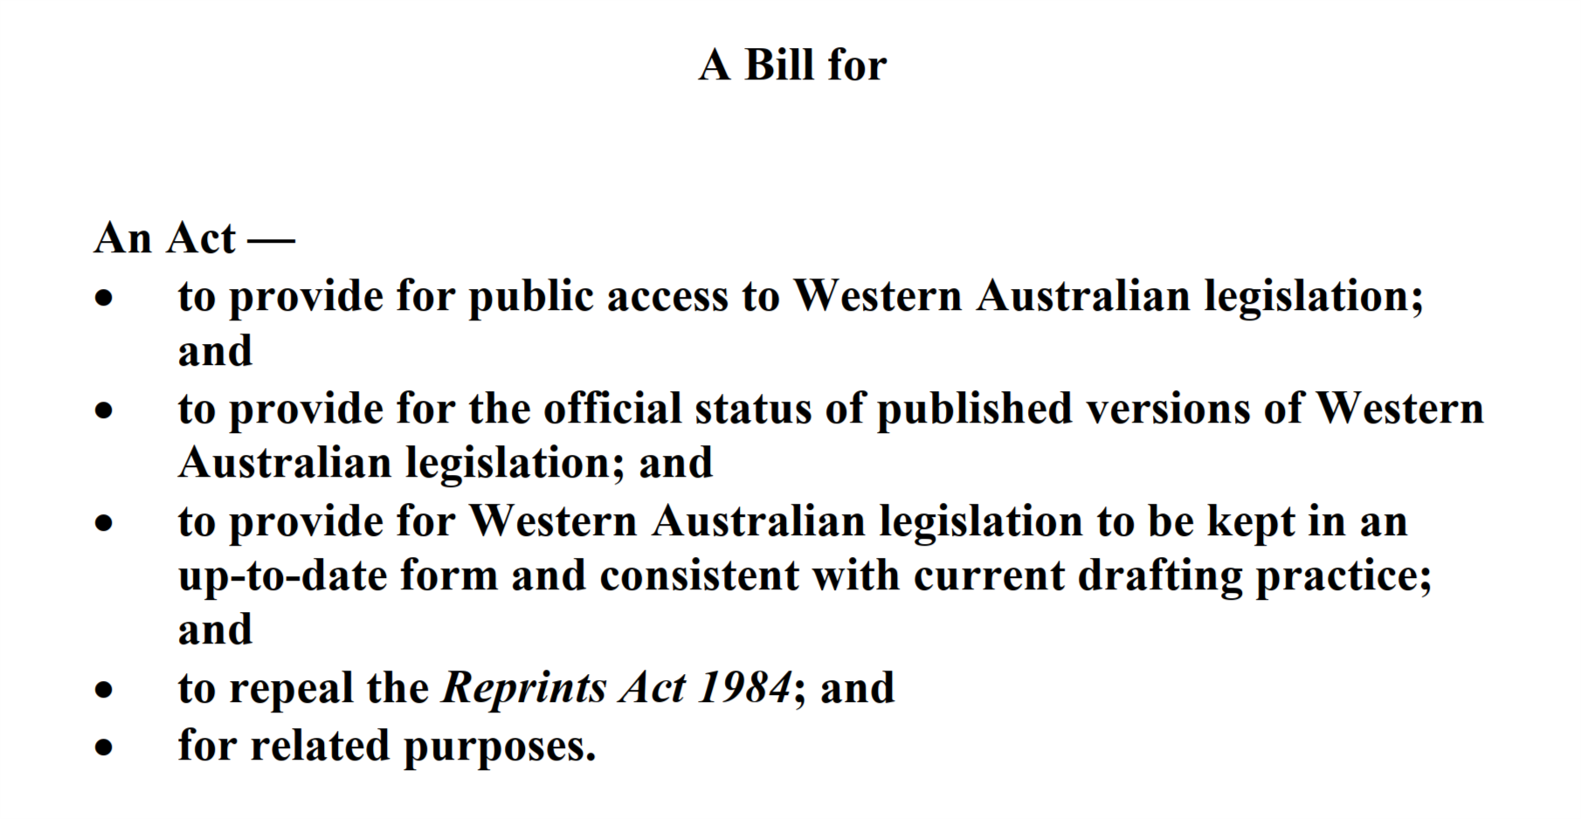
Long title

Slide 13
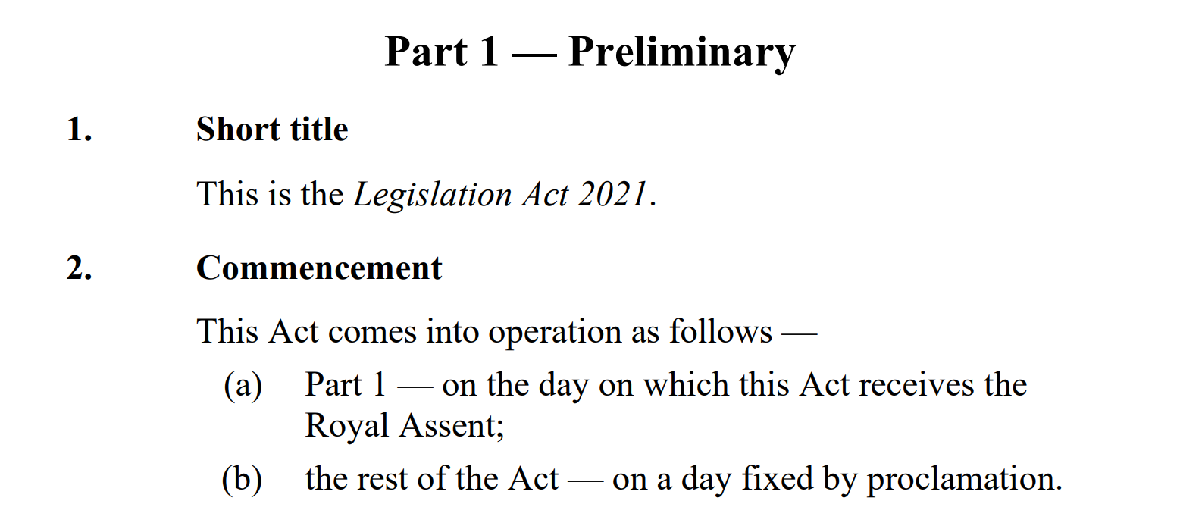
Short title and commencement

Slide 14
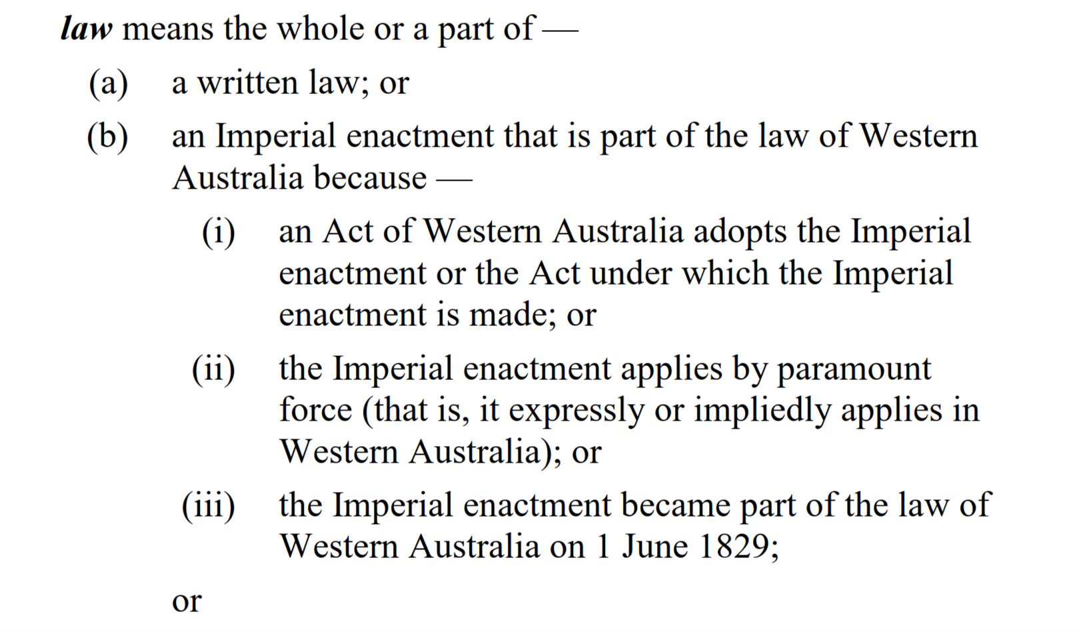
Definition

Slide 15
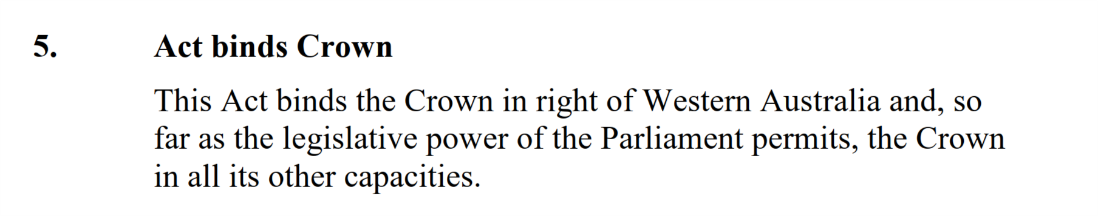
Act binds Crown

Slide 16
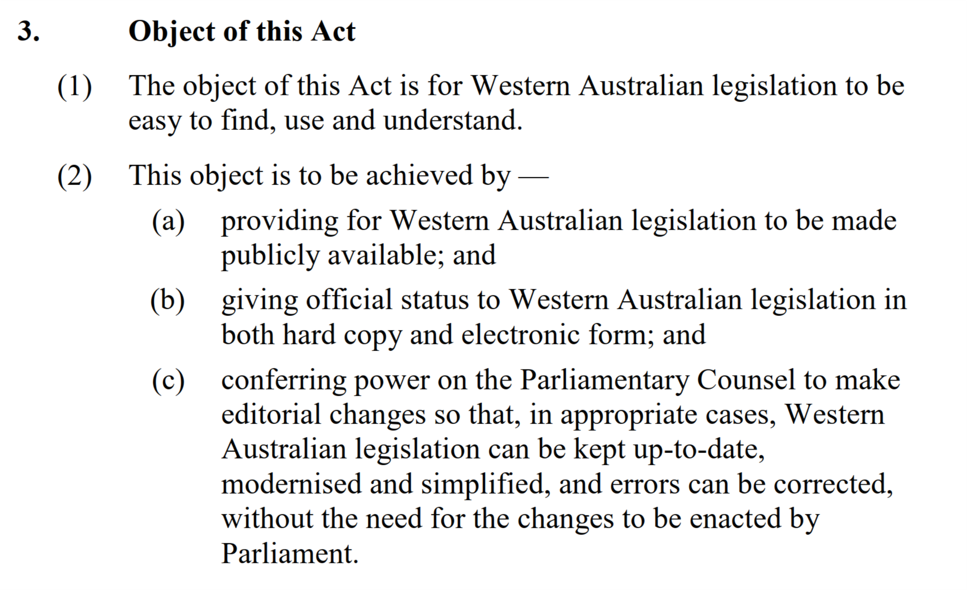
Object/purpose

Slide 17
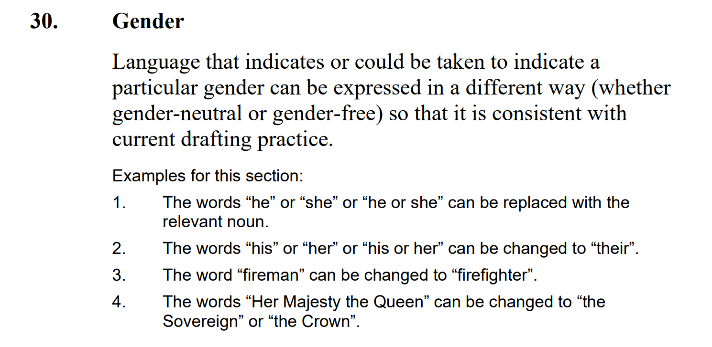
Example

Slide 18
Law relating to statutory interpretation
A topic in itself
Pearce “Statutory Interpretation in Australia” (10th edition)
Barnes, Dharmananda & Moran “Modern Statutory Interpretation: Framework, Principles and Practice”
High Court of Australia:
  SZTAL v Minister for Immigration and Border Protection [2017] HCA 34 at [14]

Slide 19
Contemporary approach to statutory interpretation in Australia
“The starting point for the ascertainment of the meaning of a statutory provision is the text of the statute whilst, at the same time, regard is had to its context and purpose. Context should be regarded at this first stage and not at some later stage and it should be regarded in its widest sense. This is not to deny the importance of the natural and ordinary meaning of a word, namely how it is ordinarily understood in discourse, to the process of construction. Considerations of context and purpose simply recognise that, understood in its statutory, historical or other context, some other meaning of a word may be suggested, and so too, if its ordinary meaning is not consistent with the statutory purpose, that meaning must be rejected.”
SZTAL v Minister for Immigration and Border Protection [2017] HCA 34 at [14]

Slide 20
Some Acts that can affect meaning
Interpretation Act 1984
Sentencing Act 1995
Criminal Procedure Act 2004
The Criminal Code
Evidence Act 1906

Slide 21
How to work out meaning
Text
Definitions
Some words have legal or technical meanings
Context
Interpretation that best achieves purpose

Slide 22
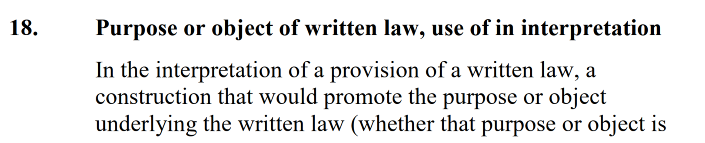

Promoting purpose or object

Slide 23
Helpful things
Table of contents
List of defined terms
Compilation table
Editorial changes table
Uncommenced provisions table

Slide 24
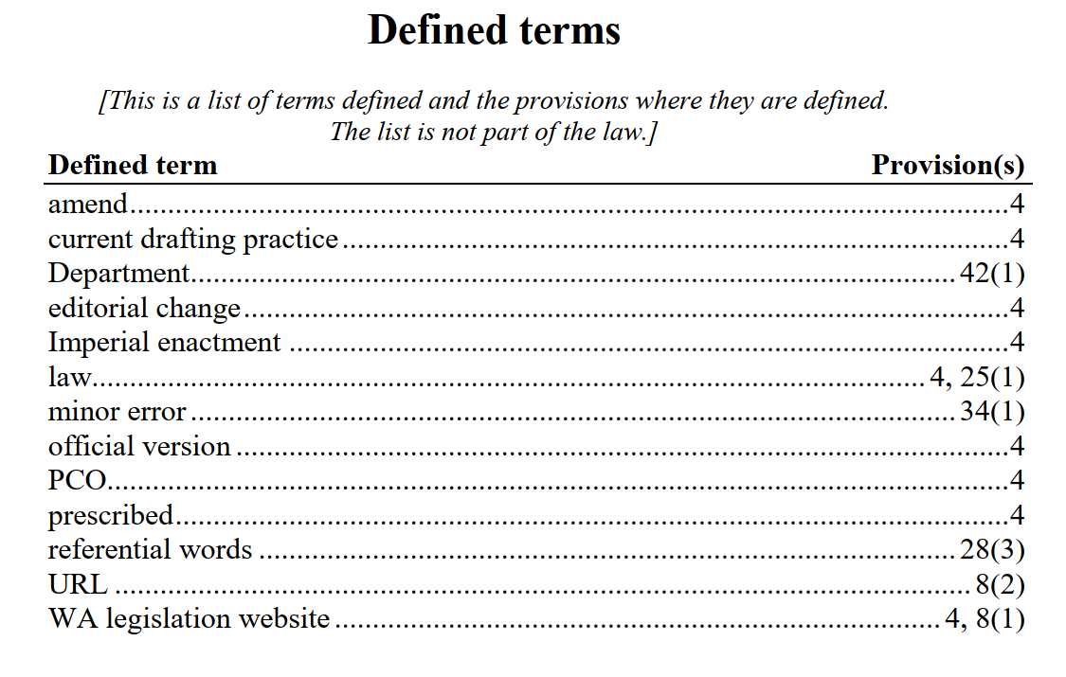
List of defined terms

Slide 25
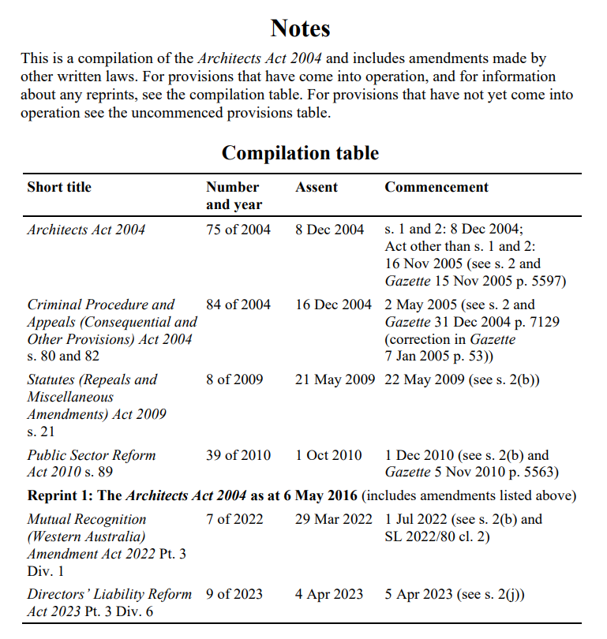

Slide 26
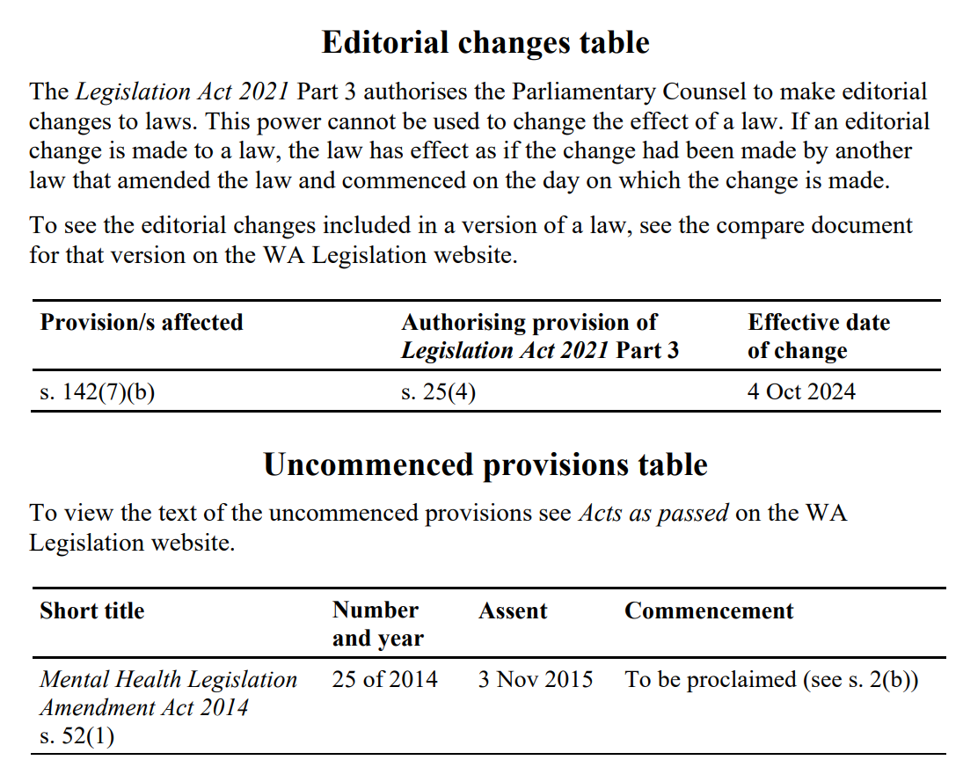

Slide 27
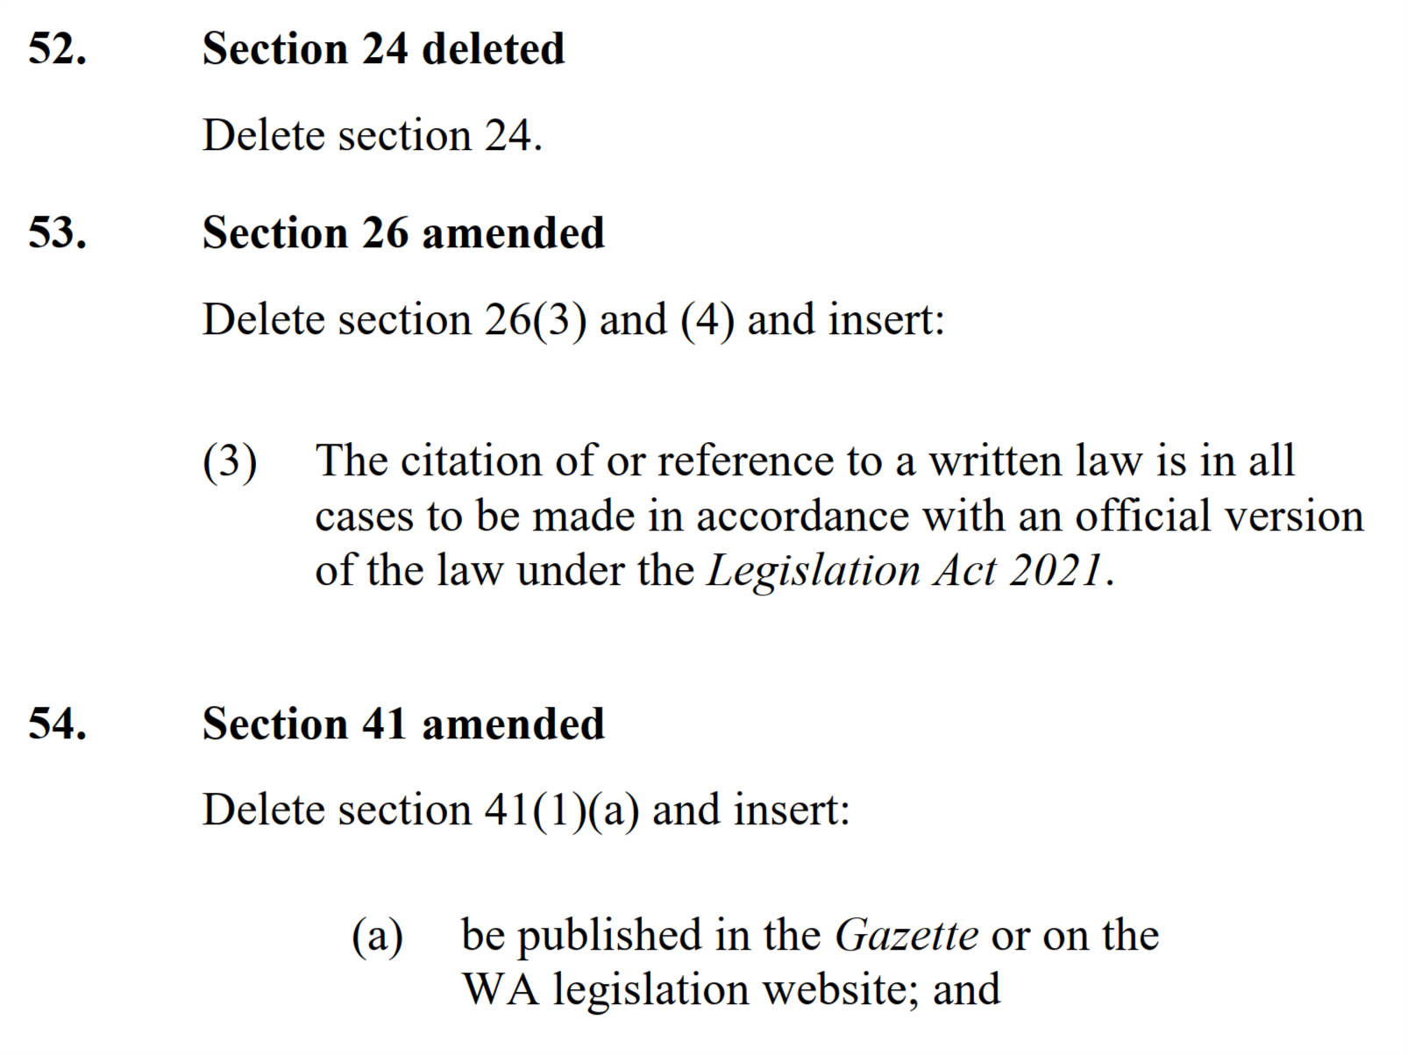
Amending Bills

Slide 28
Marked up principal Acts
(“Blue Bills”)
Produced when a Bill amends 1 or more principal Acts
Shows proposed amendments in track changes format
Available on Parliament website when Bill introduced
Usually updated if Bill amended during passage

Slide 29
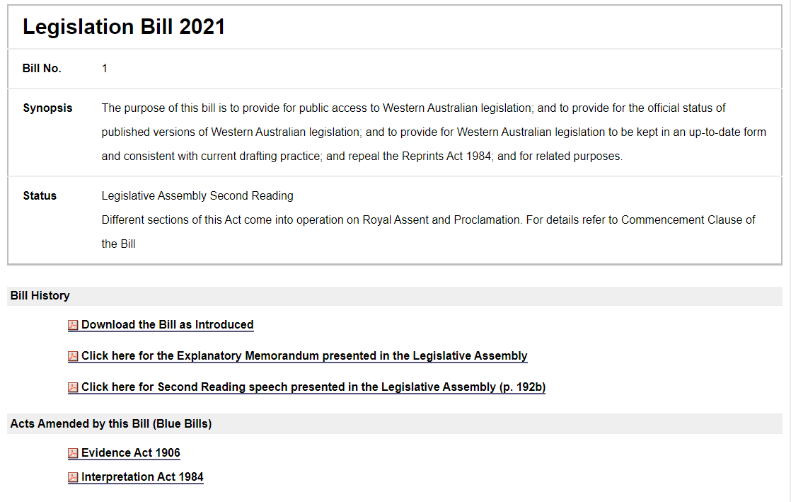

Slide 30
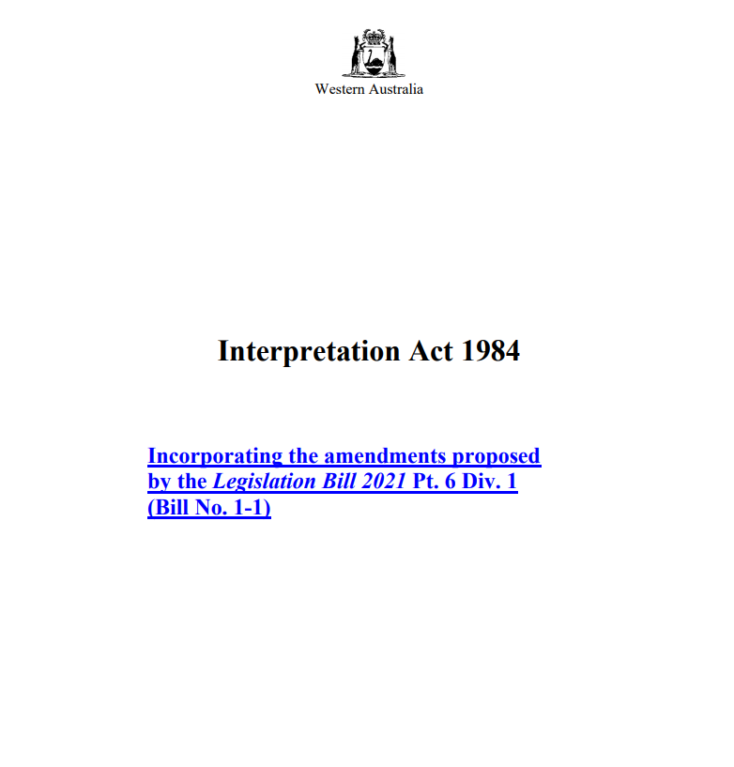

Slide 31
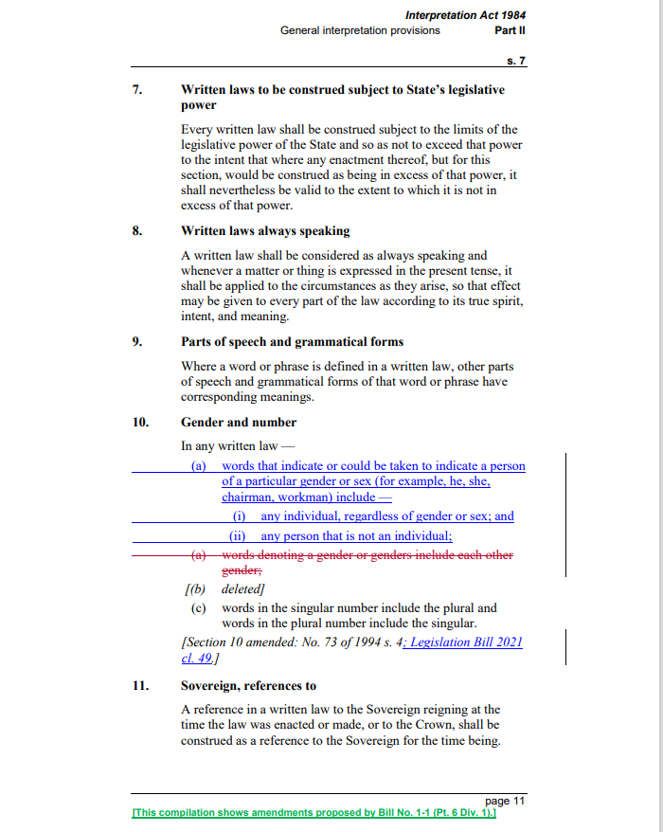

Slide 32

Further information
WA legislation website:
  Frequently Asked Questions (FAQ)
  Getting Government Legislation Drafted and Enacted - Guidelines and Procedures
Parliament of WA - Learn How Parliament Works
  How a Bill becomes a Law
  Passage of Legislation

